Slide 1

RAG from scratch: Query Translation
(HyDE)
Lance Martin
Software Engineer, LangChain
@RLanceMartin
Notes:
HyDE (Hypothetical Document Embeddings) is an approach to improve retrieval that generates hypothetical documents that could be used to answer the user input question. These documents, drawn from the LLMs knowledge, are embedded and used to retrieve documents from an index. The idea is that hypothetical documents may be better aligned with the indexes documents than the raw user question.
Slides:
https://docs.google.com/presentation/d/10MmB_QEiS4m00xdyu-92muY-8jC3CdaMpMXbXjzQXsM/edit?usp=sharing
Code:
https://github.com/langchain-ai/rag-from-scratch/blob/main/rag_from_scratch_5_to_9.ipynb
Reference:
https://arxiv.org/pdf/2212.10496.pdf

Slide 2
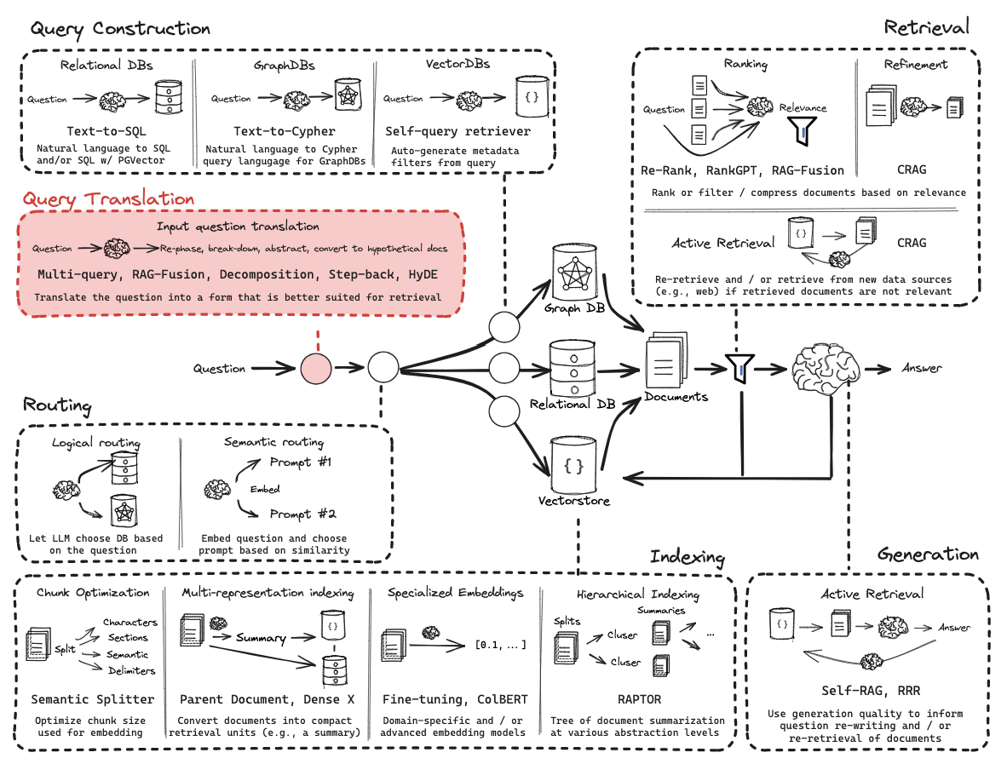
Query Translation

Slide 3
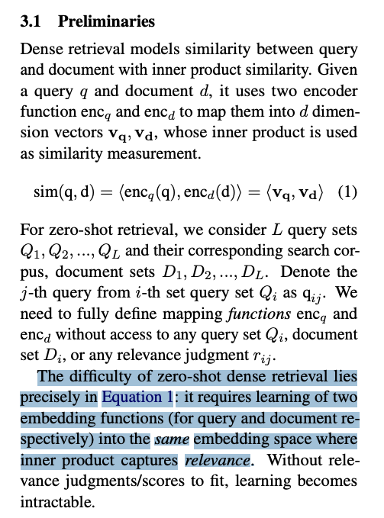
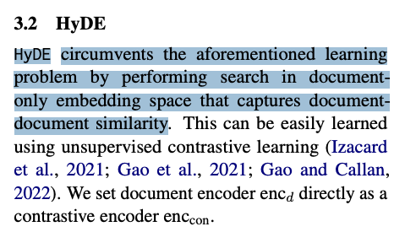
General approaches to transform questions
https://arxiv.org/pdf/2212.10496.pdf

Slide 4
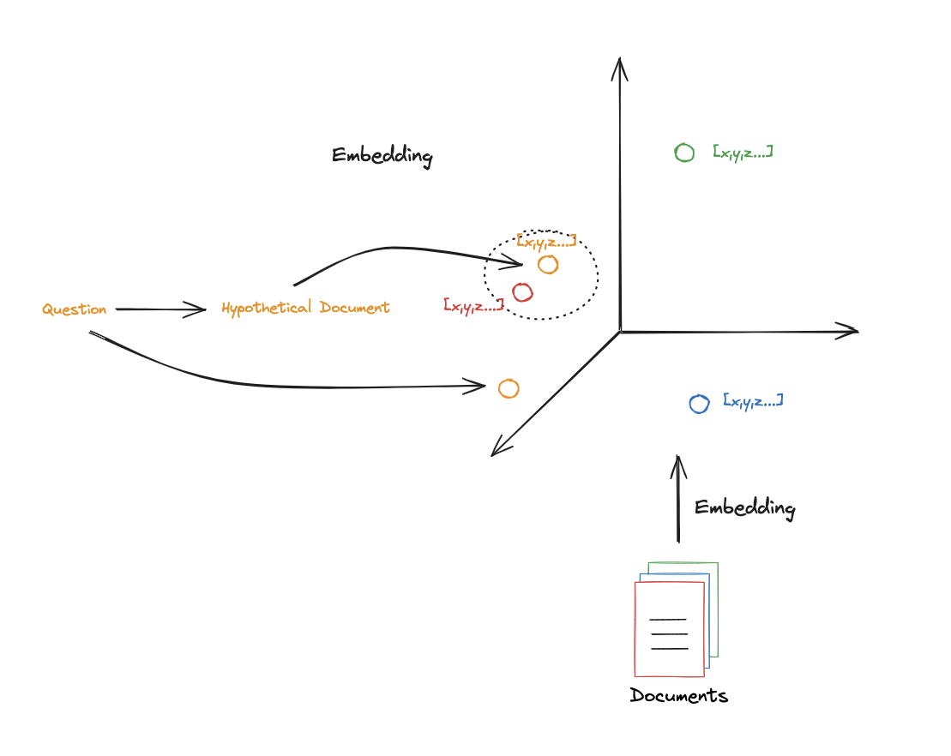
Intuition

Slide 5
Code walk-through

